Slide 1



Lecture Slides
Chapter 5
Failures Resulting from Static Loading
© 2015 by McGraw-Hill Education. This is proprietary material solely for authorized instructor use. Not authorized for sale or distribution in any manner. This document may not be copied, scanned, duplicated, forwarded, distributed, or posted on a website, in whole or part.

Slide 2
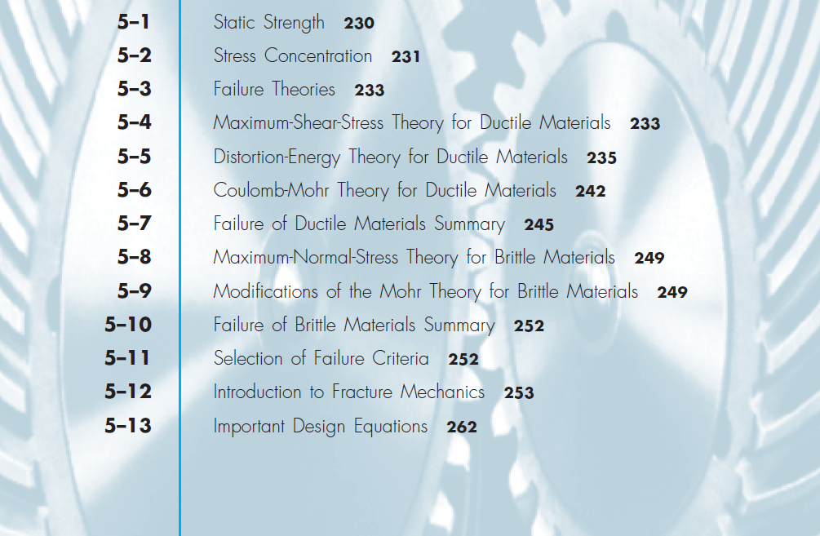
Chapter Outline

Slide 3
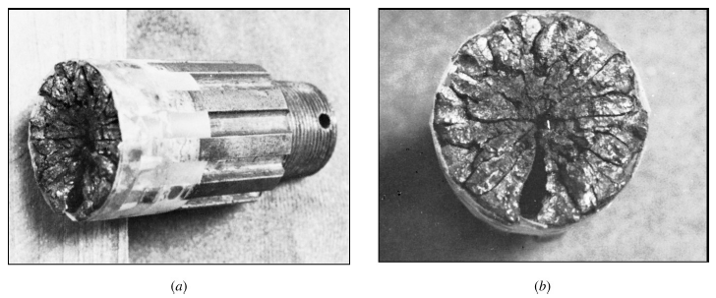
Failure Examples
Fig. 5–1
Failure of truck driveshaft spline due to corrosion fatigue

Slide 4
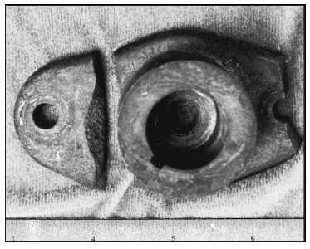
Failure Examples
Fig. 5–2
Impact failure of a lawn-mower blade driver hub.
The blade impacted a surveying pipe marker.

Slide 5
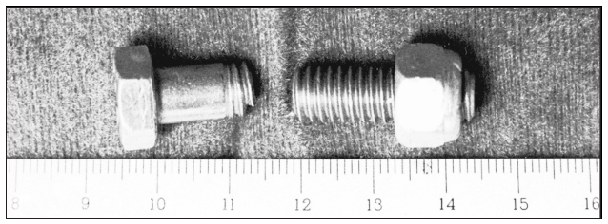
Failure Examples
Fig. 5–3
Failure of an overhead-pulley retaining bolt on a weightlifting machine.
A manufacturing error caused a gap that forced the bolt to take the entire moment load.

Slide 6
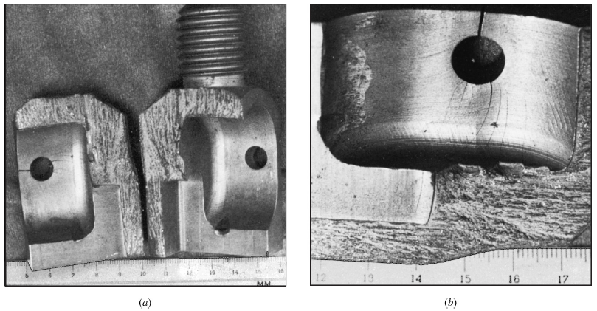
Failure Examples
Fig. 5–4
Chain test fixture that failed in one cycle.
To alleviate complaints of excessive wear, the manufacturer decided to case-harden the material
(a) Two halves showing brittle fracture initiated by stress concentration
(b) Enlarged view showing cracks induced by stress concentration at the support-pin holes

Slide 7
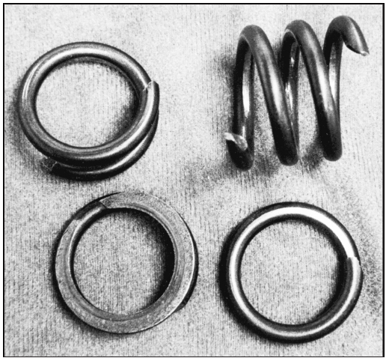
Failure Examples
Fig. 5–5
Valve-spring failure caused by spring surge in an oversped engine.
The fractures exhibit the classic 45 degree shear failure

Slide 8
Static Strength
Usually necessary to design using published strength values
Experimental test data is better, but generally only warranted for large quantities or when failure is very costly (in time, expense, or life)
Methods are needed to safely and efficiently use published strength values for a variety of situations

Slide 9
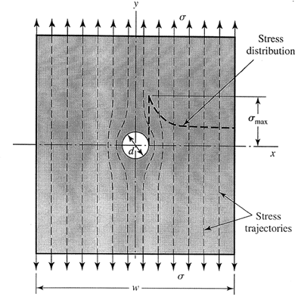
Stress Concentration
Localized increase of stress near discontinuities
K_{t} is Theoretical (Geometric) Stress Concentration Factor

Slide 10
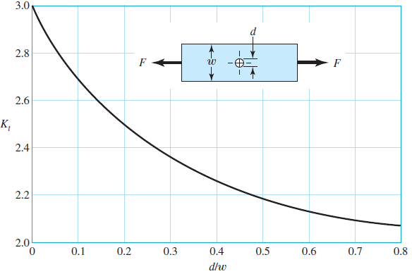
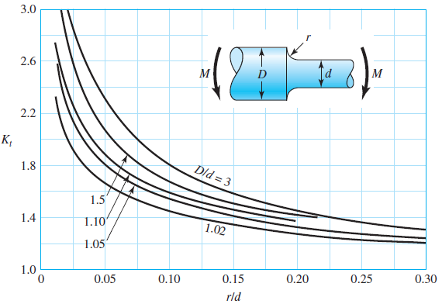
Theoretical Stress Concentration Factor
Graphs available for standard configurations
See Appendix A–15 and A–16 for common examples
Many more in Peterson’s Stress-Concentration Factors
Note the trend for higher Kt at sharper discontinuity radius, and at greater disruption
Fig. A–15–1
Fig. A–15–9

Slide 11
Stress Concentration for Static and Ductile Conditions
With static loads and ductile materials
Highest stressed fibers yield (cold work)
Load is shared with next fibers
Cold working is localized
Overall part does not see damage unless ultimate strength is exceeded
Stress concentration effect is commonly ignored for static loads on ductile materials
Stress concentration must be included for dynamic loading (See Ch. 6)
Stress concentration must be included for brittle materials, since localized yielding may reach brittle failure rather than cold-working and sharing the load.

Slide 12
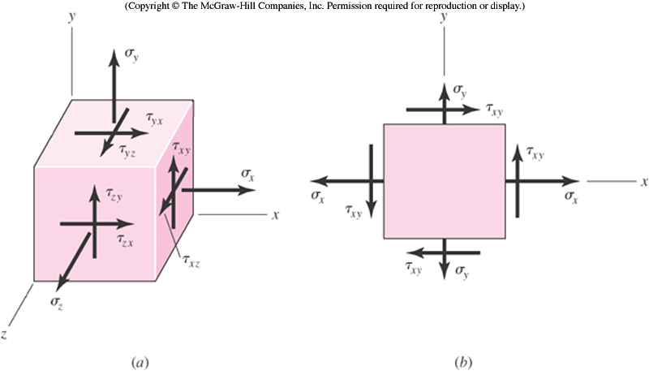
Need for Static Failure Theories
Uniaxial stress element (e.g. tension test)
Multi-axial stress element
One strength, multiple stresses
How to compare stress state to single strength?

Slide 13
Need for Static Failure Theories
Failure theories propose appropriate means of comparing multi-axial stress states to single strength
Usually based on some hypothesis of what aspect of the stress state is critical
Some failure theories have gained recognition of usefulness for various situations

Slide 14
Maximum Normal (Principal) Stress Theory
Theory: Yielding begins when the maximum principal stress in a stress element exceeds the yield strength.
For any stress element, use Mohr’s circle to find the principal stresses.
Compare the largest principal stress to the yield strength.
Often the first theory to be proposed by engineering students.
Is it a good theory?

Slide 15
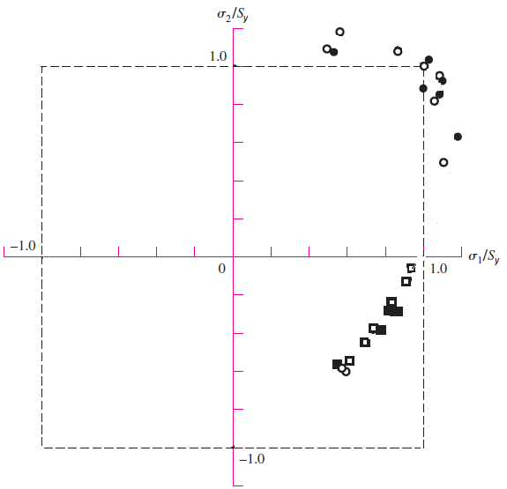
Maximum Normal (Principal) Stress Theory
Experimental data shows the theory is unsafe in the 4th quadrant.
This theory is not safe to use for ductile materials.

Slide 16
Maximum Shear Stress Theory (MSS)
Theory: Yielding begins when the maximum shear stress in a stress element exceeds the maximum shear stress in a tension test specimen of the same material when that specimen begins to yield.
For a tension test specimen, the maximum shear stress is σ₁ /2.
At yielding, when σ₁ = S_{y}, the maximum shear stress is S_{y} /2 .
Could restate the theory as follows:
Theory: Yielding begins when the maximum shear stress in a stress element exceeds S_{y}/2.

Slide 17
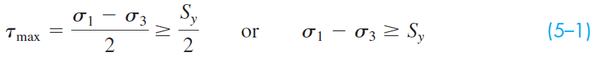
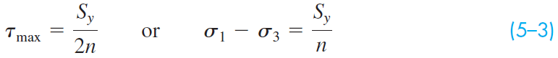
Maximum Shear Stress Theory (MSS)
For any stress element, use Mohr’s circle to find the maximum shear stress. Compare the maximum shear stress to S_{y}/2.
Ordering the principal stresses such that σ₁ ≥ σ₂ ≥ σ_{3,}
Incorporating a factor of safety n
Or solving for factor of safety

Slide 18
Maximum Shear Stress Theory (MSS)
To compare to experimental data, express τ_{max} in terms of principal stresses and plot.
To simplify, consider a plane stress state
Let σ_{A} and σ_{B} represent the two non-zero principal stresses, then order them with the zero principal stress such that σ₁ ≥ σ₂ ≥ σ₃
Assuming σ_{A} ≥ σ_{B} there are three cases to consider
Case 1: σ_{A} ≥ σ_{B} ≥ 0
Case 2: σ_{A} ≥ 0 ≥ σ_{B}
Case 3: 0 ≥ σ_{A} ≥ σ_{B}

Slide 19
Maximum Shear Stress Theory (MSS)
Case 1: σ_{A} ≥ σ_{B} ≥ 0
For this case, σ₁ = σ_{A} and σ₃ = 0
Eq. (5–1) reduces to σ_{A} ≥ S_{y}
Case 2: σ_{A} ≥ 0 ≥ σ_{B}
For this case, σ₁ = σ_{A} and σ₃ = σ_{B}
Eq. (5–1) reduces to σ_{A} − σ_{B} ≥ S_{y}
Case 3: 0 ≥ σ_{A} ≥ σ_{B}
For this case, σ₁ = 0 and σ₃ = σ_{B}
Eq. (5–1) reduces to σ_{B} ≤ −S_{y}

Slide 20
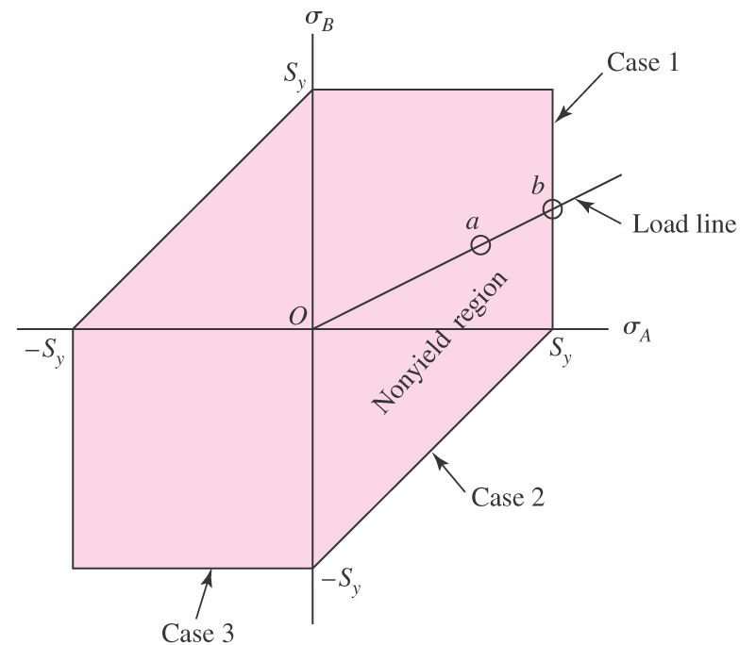
Maximum Shear Stress Theory (MSS)
Plot three cases on principal stress axes
Case 1: σ_{A} ≥ σ_{B} ≥ 0
σ_{A} ≥ S_{y}
Case 2: σ_{A} ≥ 0 ≥ σ_{B}
σ_{A} − σ_{B} ≥ S_{y}
Case 3: 0 ≥ σ_{A} ≥ σ_{B}
σ_{B} ≤ −S_{y}
Other lines are symmetric cases
Inside envelope is predicted safe zone
Fig. 5–7

Slide 21
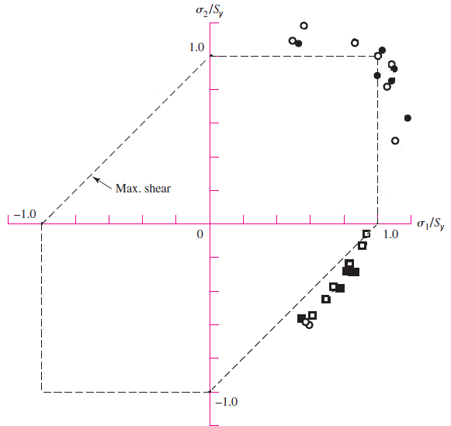
Maximum Shear Stress Theory (MSS)
Comparison to experimental data
Conservative in all quadrants
Commonly used for design situations

Slide 22
Distortion Energy (DE) Failure Theory
Also known as:
Octahedral Shear Stress
Shear Energy
Von Mises
Von Mises – Hencky

Slide 23
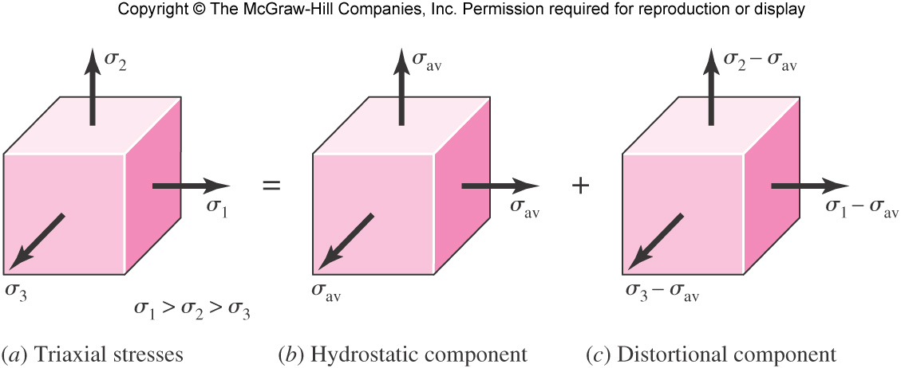
Distortion Energy (DE) Failure Theory
Originated from observation that ductile materials stressed hydrostatically (equal principal stresses) exhibited yield strengths greatly in excess of expected values.
Theorizes that if strain energy is divided into hydrostatic volume changing energy and angular distortion energy, the yielding is primarily affected by the distortion energy.
Fig. 5–8

Slide 24
Distortion Energy (DE) Failure Theory
Theory: Yielding occurs when the distortion strain energy per unit volume reaches the distortion strain energy per unit volume for yield in simple tension or compression of the same material.
Fig. 5–8

Slide 25
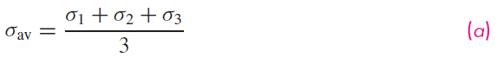
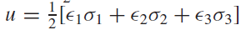
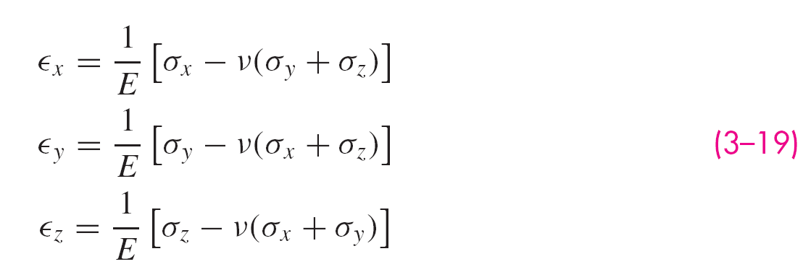
Deriving the Distortion Energy
Hydrostatic stress is average of principal stresses
Strain energy per unit volume,
Substituting Eq. (3–19) for principal strains into strain energy equation,

Slide 26
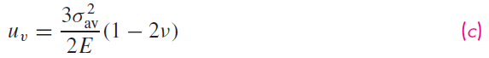
Deriving the Distortion Energy
Strain energy for producing only volume change is obtained by substituting σ_{av} for σ₁, σ₂, and σ₃
Substituting σ_{av} from Eq. (a),
Obtain distortion energy by subtracting volume changing energy, Eq. (5–7), from total strain energy, Eq. (b)

Slide 27
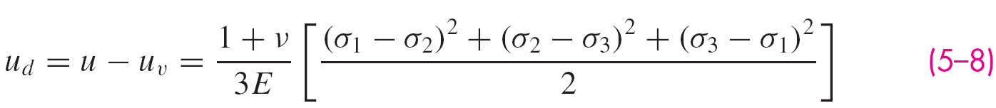
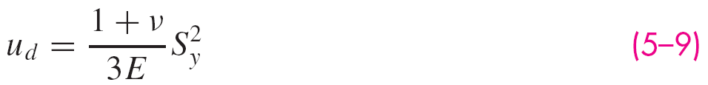
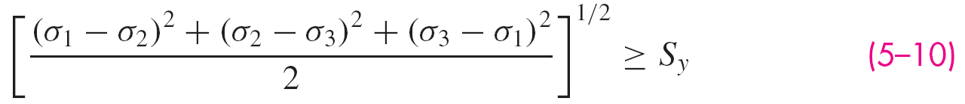
Deriving the Distortion Energy
Tension test specimen at yield has σ₁ = S_{y} and σ₂ = σ₃ =0
Applying to Eq. (5–8), distortion energy for tension test specimen is
DE theory predicts failure when distortion energy, Eq. (5–8), exceeds distortion energy of tension test specimen, Eq. (5–9)

Slide 28
Von Mises Stress
Left hand side is defined as von Mises stress
For plane stress, simplifies to
In terms of xyz components, in three dimensions
In terms of xyz components, for plane stress

Slide 29
Distortion Energy Theory With Von Mises Stress
Von Mises Stress can be thought of as a single, equivalent, or effective stress for the entire general state of stress in a stress element.
Distortion Energy failure theory simply compares von Mises stress to yield strength.
Introducing a design factor,
Expressing as factor of safety,

Slide 30
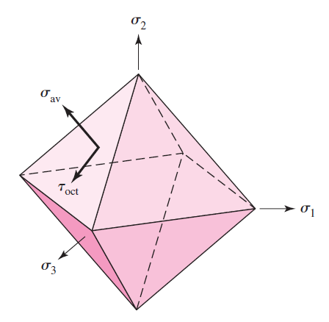
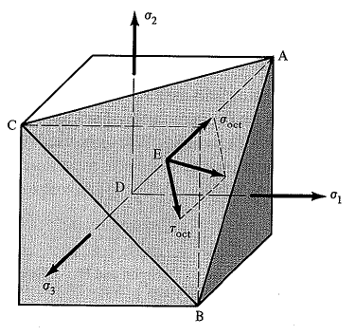
Octahedral Stresses
Same results obtained by evaluating octahedral stresses.
Octahedral stresses are identical on 8 surfaces symmetric to the principal stress directions.
Octahedral stresses allow representation of any stress situation with a set of normal and shear stresses.
Principal stress element with single octahedral plane showing
All 8 octahedral planes showing

Slide 31
Octahedral Shear Stress
Octahedral normal stresses are normal to the octahedral surfaces, and are equal to the average of the principal stresses.
Octahedral shear stresses lie on the octahedral surfaces.
Fig. 5–10

Slide 32
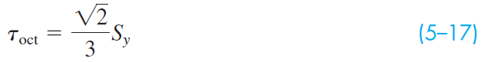
Octahedral Shear Stress Failure Theory
Theory: Yielding begins when the octahedral shear stress in a stress element exceeds the octahedral shear stress in a tension test specimen at yielding.
The octahedral shear stress is
For a tension test specimen at yielding, σ₁ = S_{y} , σ₂ = σ₃ = 0. Substituting into Eq. (5–16),
The theory predicts failure when Eq. (5–16) exceeds Eq. (5–17). This condition reduces to

Slide 33
Failure Theory in Terms of von Mises Stress
Equation is identical to Eq. (5–10) from Distortion Energy approach
Identical conclusion for:
Distortion Energy
Octahedral Shear Stress
Shear Energy
Von Mises
Von Mises – Hencky

Slide 34
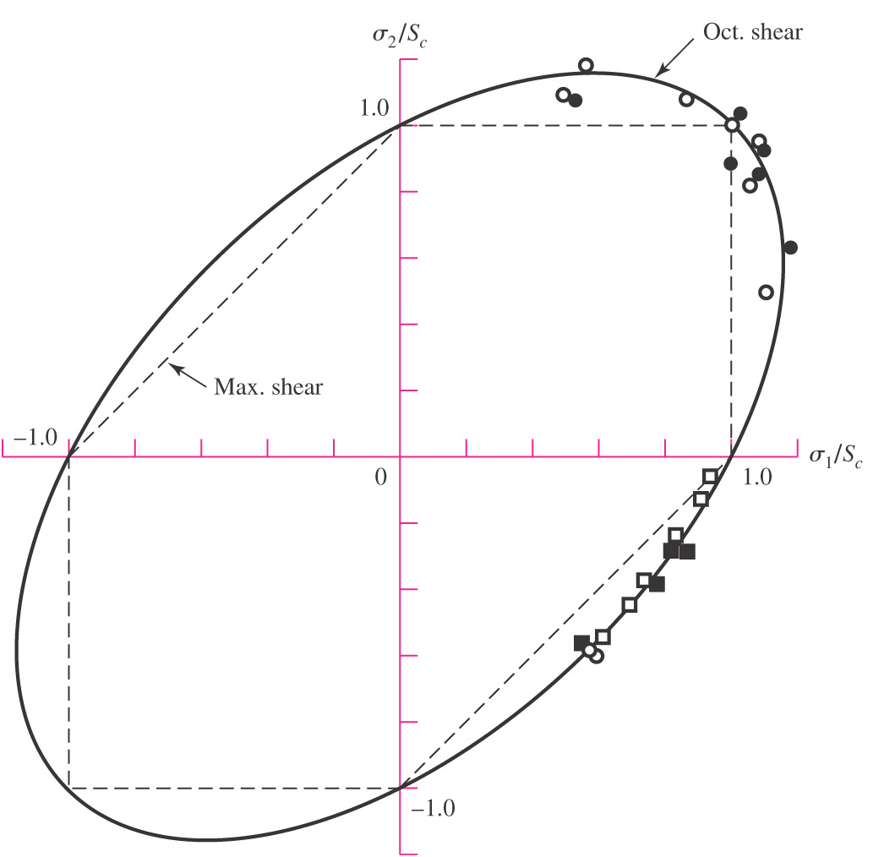
DE Theory Compared to Experimental Data
Plot von Mises stress on principal stress axes to compare to experimental data (and to other failure theories)
DE curve is typical of data
Note that typical equates to a 50% reliability from a design perspective
Commonly used for analysis situations
MSS theory useful for design situations where higher reliability is desired
Fig. 5–15

Slide 35
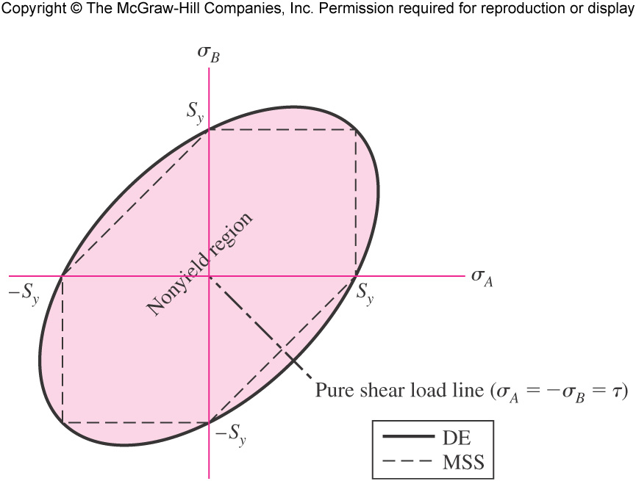
Shear Strength Predictions
For pure shear loading, Mohr’s circle shows that σ_{A} = −σ_{B} = τ
Plotting this equation on principal stress axes gives load line for pure shear case
Intersection of pure shear load line with failure curve indicates shear strength has been reached
Each failure theory predicts shear strength to be some fraction of normal strength
Fig. 5–9

Slide 36
Shear Strength Predictions
For MSS theory, intersecting pure shear load line with failure line [Eq. (5–5)] results in
Fig. 5–9

Slide 37
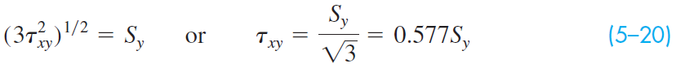
Shear Strength Predictions
For DE theory, intersection pure shear load line with failure curve [Eq. (5–11)] gives
Therefore, DE theory predicts shear strength as
Fig. 5–9

Slide 38
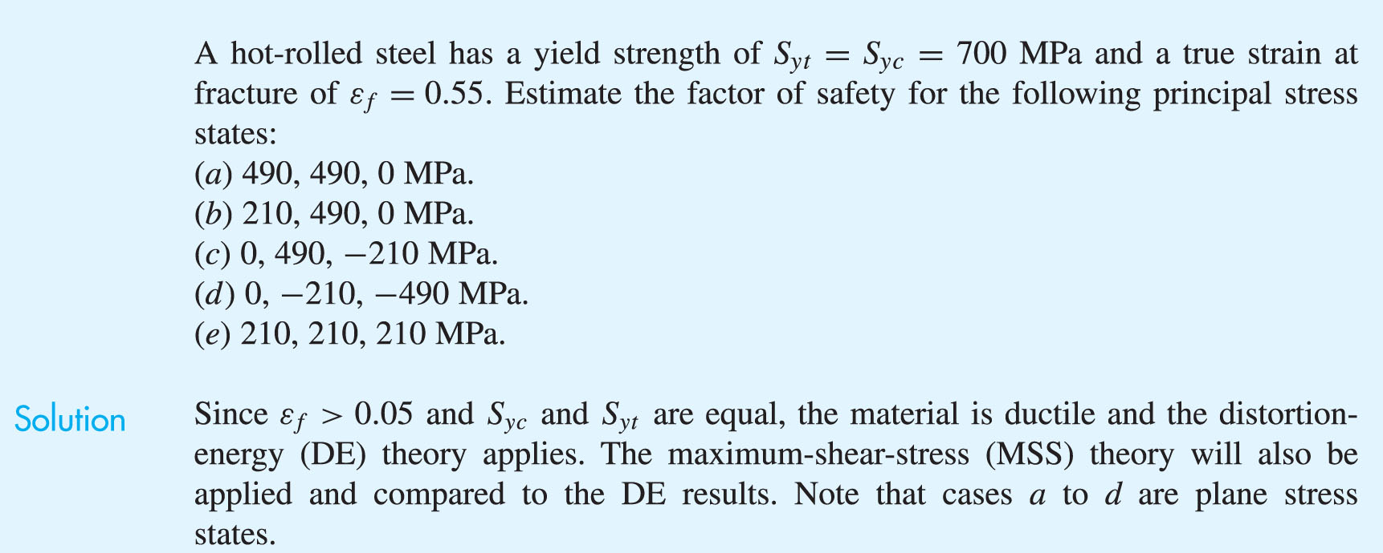
Example 5–1

Slide 39
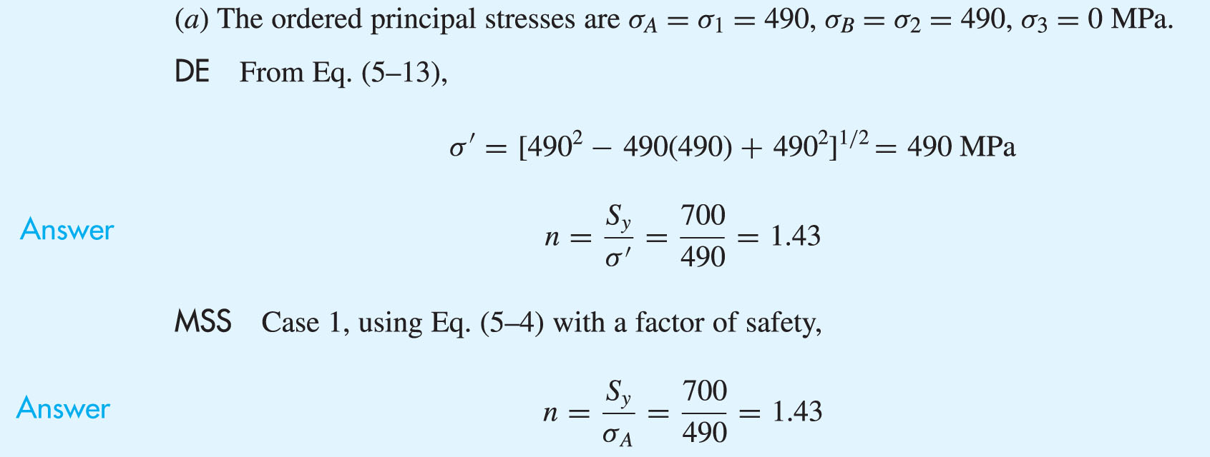
Example 5–1 (continued)

Slide 40
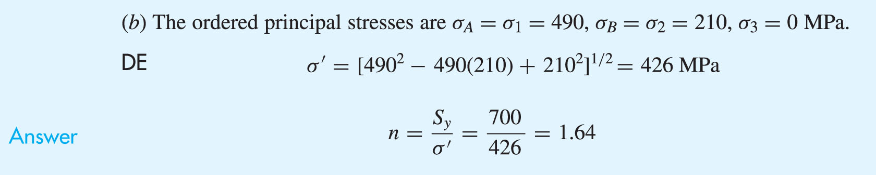

Example 5–1 (continued)

Slide 41
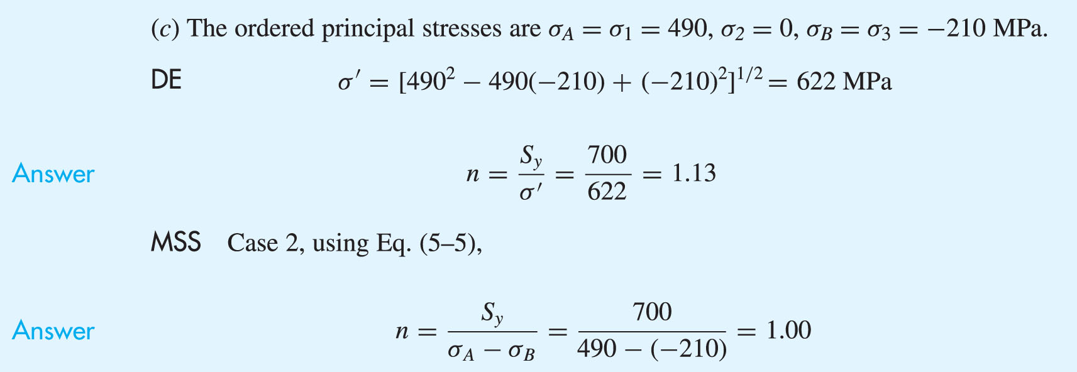
Example 5–1 (continued)

Slide 42
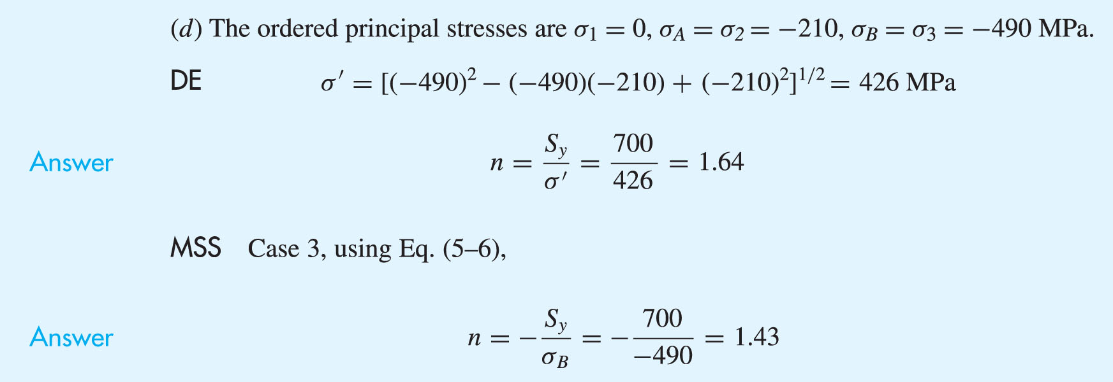
Example 5–1 (continued)

Slide 43
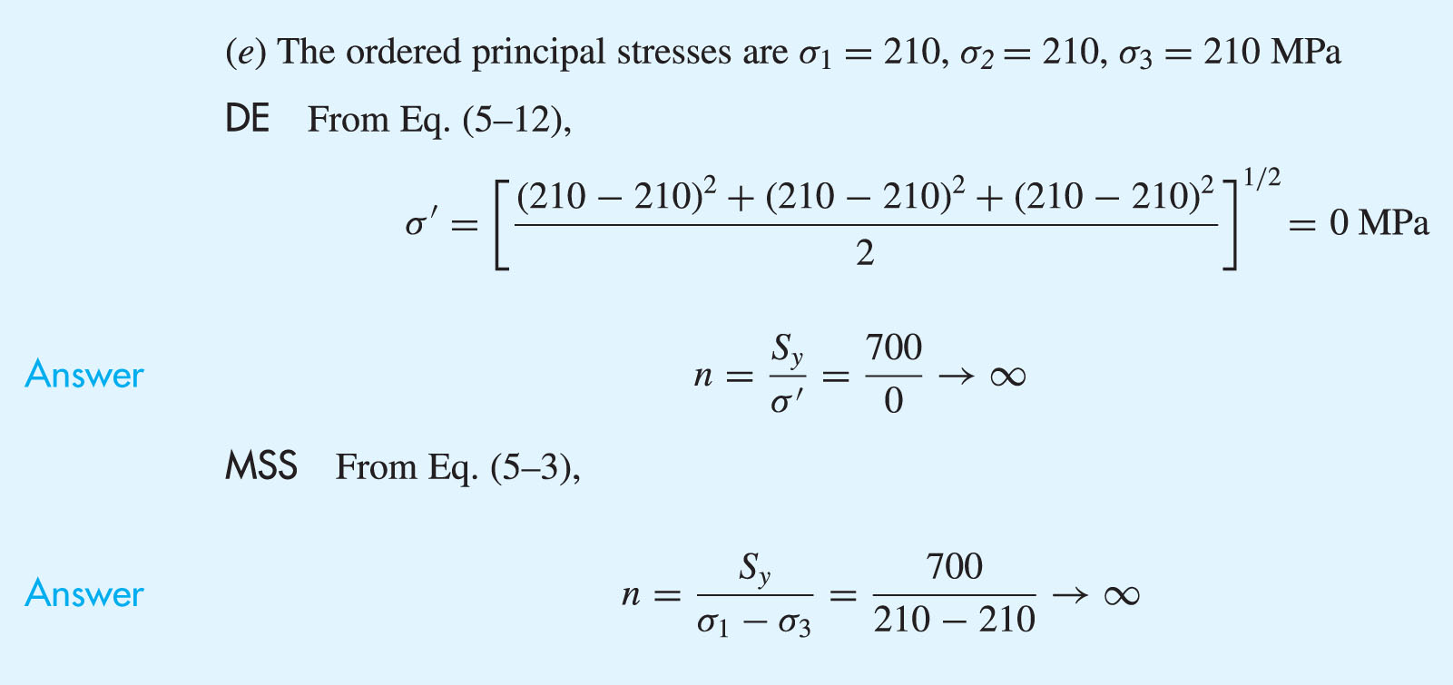
Example 5–1 (continued)

Slide 44
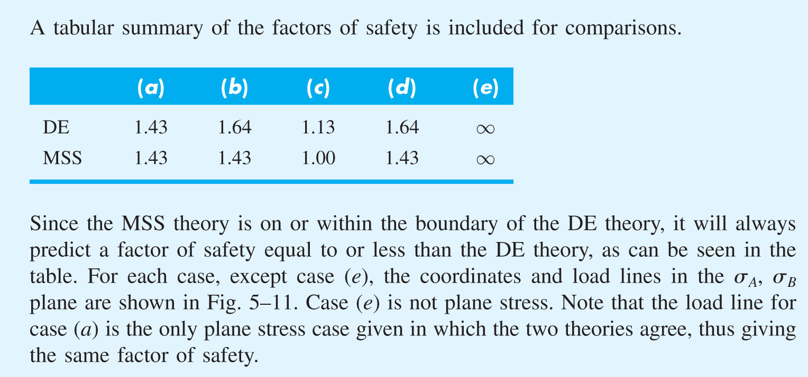
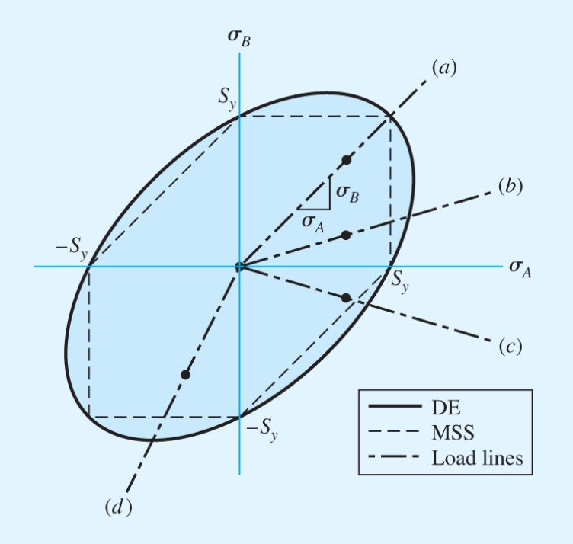
Example 5–1 (continued)
Fig. 5−11

Slide 45
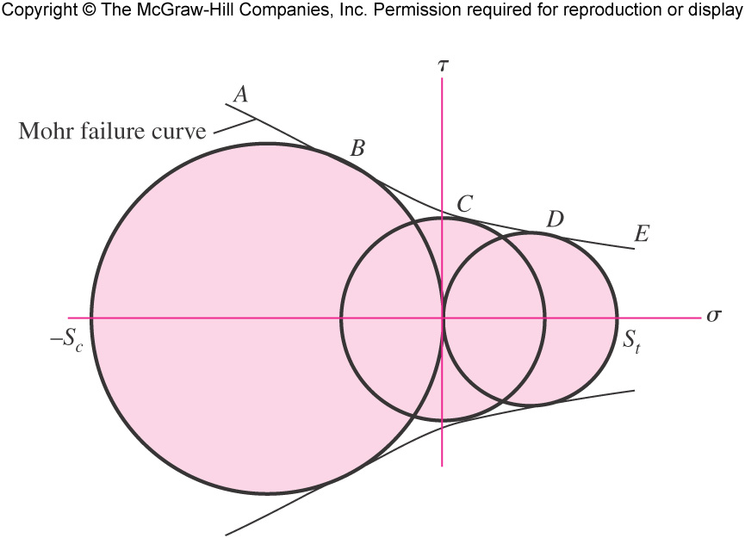
Mohr Theory
Some materials have compressive strengths different from tensile strengths
Mohr theory is based on three simple tests: tension, compression, and shear
Plotting Mohr’s circle for each, bounding curve defines failure envelope
Fig. 5−12

Slide 46
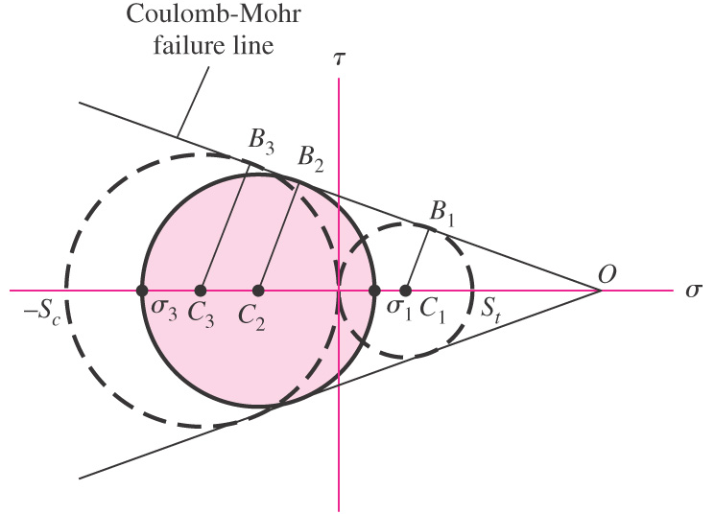
Coulomb-Mohr Theory
Curved failure curve is difficult to determine analytically
Coulomb-Mohr theory simplifies to linear failure envelope using only tension and compression tests (dashed circles)
Fig. 5−13

Slide 47
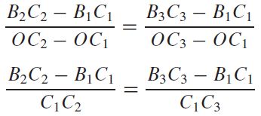
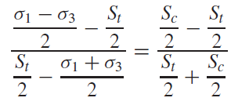
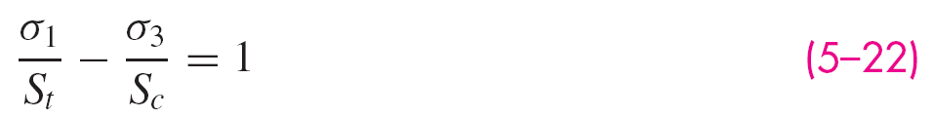
Coulomb-Mohr Theory
From the geometry, derive the failure criteria
Fig. 5−13

Slide 48
Coulomb-Mohr Theory
Incorporating factor of safety
For ductile material, use tensile and compressive yield strengths
For brittle material, use tensile and compressive ultimate strengths

Slide 49
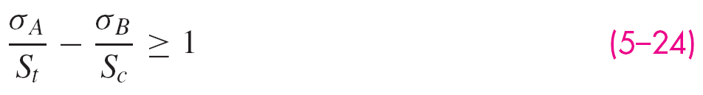
Coulomb-Mohr Theory
To plot on principal stress axes, consider three cases
Case 1: σ_{A} ≥ σ_{B} ≥ 0 For this case, σ₁ = σ_{A} and σ₃ = 0
Eq. (5−22) reduces to
Case 2: σ_{A} ≥ 0 ≥ σ_{B} For this case, σ₁ = σ_{A} and σ₃ = σ_{B}
Eq. (5-22) reduces to
Case 3: 0 ≥ σ_{A} ≥ σ_{B} For this case, σ₁ = 0 and σ₃ = σ_{B}
Eq. (5−22) reduces to

Slide 50
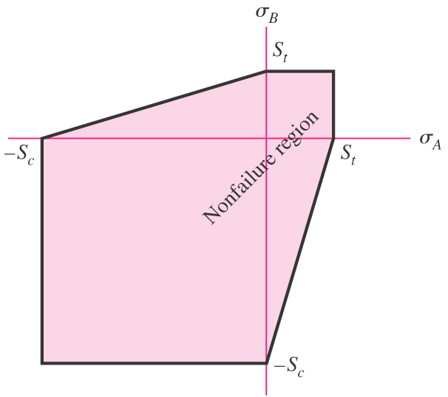
Coulomb-Mohr Theory
Plot three cases on principal stress axes
Similar to MSS theory, except with different strengths for compression and tension
Fig. 5−14

Slide 51
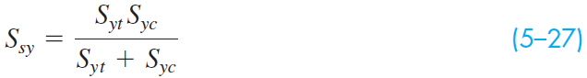
Coulomb-Mohr Theory
Intersect the pure shear load line with the failure line to determine the shear strength
Since failure line is a function of tensile and compressive strengths, shear strength is also a function of these terms.

Slide 52
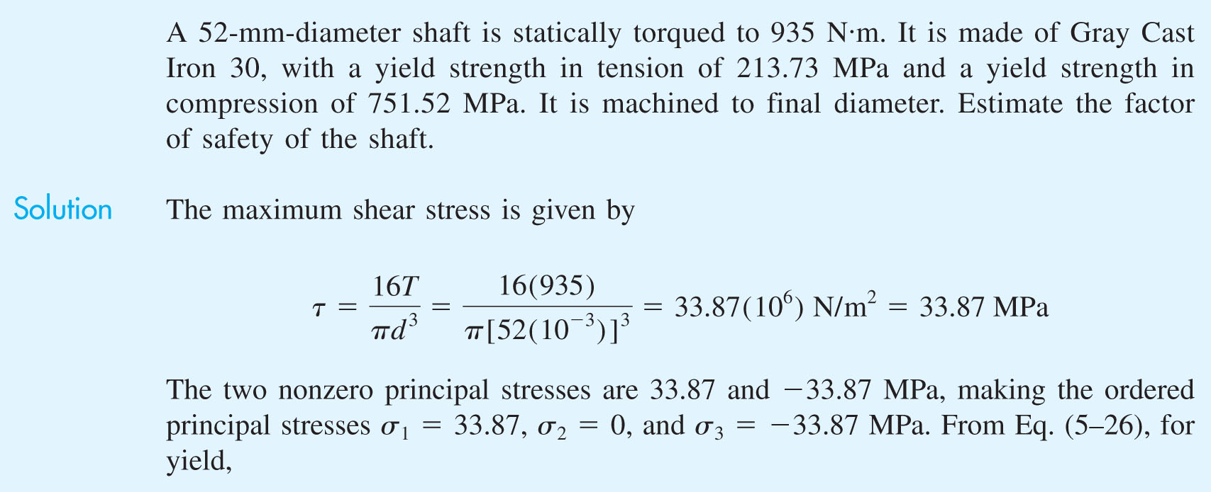
Example 5–2

Slide 53
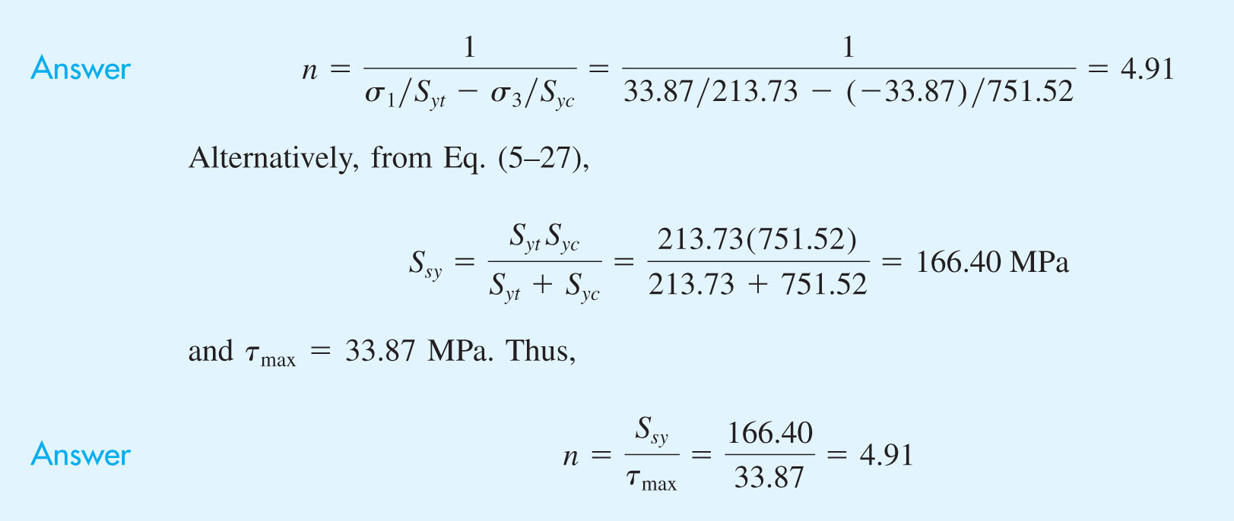
Example 5–2 (continued)

Slide 54
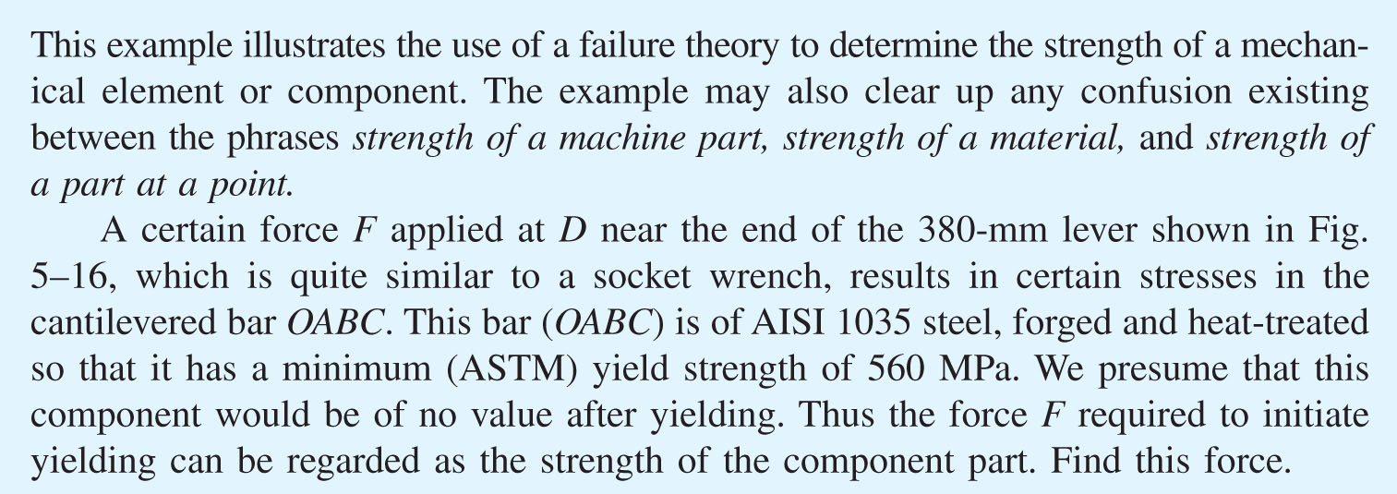
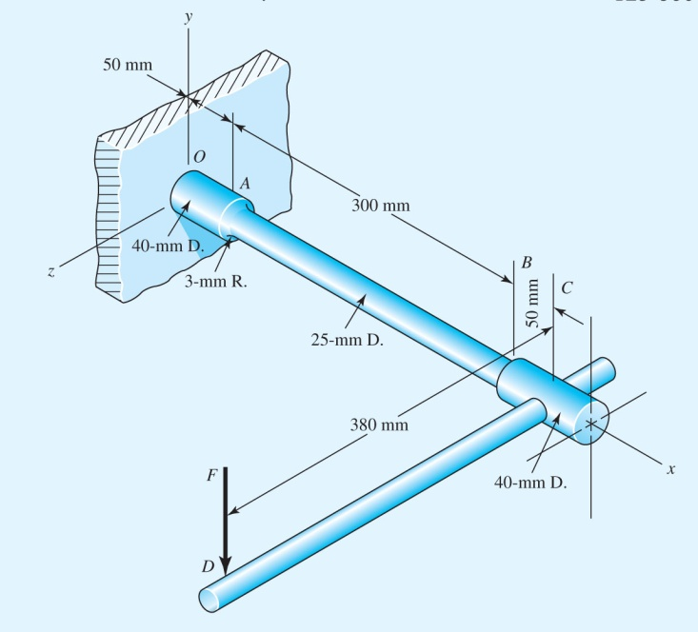
Example 5−3
Fig. 5−16

Slide 55
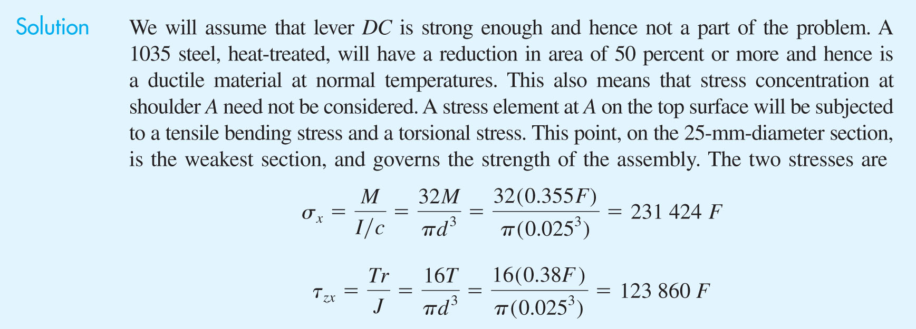

Example 5−3 (continued)

Slide 56

Example 5−3 (continued)

Slide 57


Example 5−4
Fig. 5−17

Slide 58



Example 5−4 (continued)
Fig. 5−17

Slide 59

Example 5−4 (continued)

Slide 60

Example 5−4 (continued)
Answer

Slide 61

Failure Theories for Brittle Materials
Experimental data indicates some differences in failure for brittle materials.
Failure criteria is generally ultimate fracture rather than yielding
Compressive strengths are usually larger than tensile strengths
Fig. 5−19

Slide 62

Maximum Normal Stress Theory
Theory: Failure occurs when the maximum principal stress in a stress element exceeds the strength.
Predicts failure when
For plane stress,
Incorporating design factor,

Slide 63

Maximum Normal Stress Theory
Plot on principal stress axes
Unsafe in part of fourth quadrant
Not recommended for use
Included for historical comparison
Fig. 5−18

Slide 64









Brittle Coulomb-Mohr
Same as previously derived, using ultimate strengths for failure
Failure equations dependent on quadrant
Quadrant condition
Failure criteria
Fig. 5−14

Slide 65
Brittle Failure Experimental Data
Coulomb-Mohr is conservative in 4th quadrant
Modified Mohr criteria adjusts to better fit the data in the 4th quadrant
Fig. 5−19

Slide 66




Modified-Mohr
Quadrant condition
Failure criteria

Slide 67


Example 5−5
Fig. 5−16

Slide 68

Example 5−5 (continued)

Slide 69

Example 5−5 (continued)

Slide 70
Selection of Failure Criteria
First determine ductile vs. brittle
For ductile
MSS is conservative, often used for design where higher reliability is desired
DE is typical, often used for analysis where agreement with experimental data is desired
If tensile and compressive strengths differ, use Ductile Coulomb-Mohr
For brittle
Mohr theory is best, but difficult to use
Brittle Coulomb-Mohr is very conservative in 4th quadrant
Modified Mohr is still slightly conservative in 4th quadrant, but closer to typical

Slide 71

Selection of Failure Criteria in Flowchart Form
Fig. 5−21

Slide 72
Introduction to Fracture Mechanics
Linear elastic fracture mechanics (LEFM) analyzes crack growth during service
Assumes cracks can exist before service begins, e.g. flaw, inclusion, or defect
Attempts to model and predict the growth of a crack
Stress concentration approach is inadequate when notch radius becomes extremely sharp, as in a crack, since stress concentration factor approaches infinity
Ductile materials often can neglect effect of crack growth, since local plastic deformation blunts sharp cracks
Relatively brittle materials, such as glass, hard steels, strong aluminum alloys, and steel below the ductile-to-brittle transition temperature, benefit from fracture mechanics analysis

Slide 73
Quasi-Static Fracture
Though brittle fracture seems instantaneous, it actually takes time to feed the crack energy from the stress field to the crack for propagation.
A static crack may be stable and not propagate.
Some level of loading can render a crack unstable, causing it to propagate to fracture.

Slide 74

Quasi-Static Fracture
Foundation work for fracture mechanics established by Griffith in 1921
Considered infinite plate with an elliptical flaw
Maximum stress occurs at (±a, 0)
Fig. 5−22

Slide 75
Quasi-Static Fracture
Crack growth occurs when energy release rate from applied loading is greater than rate of energy for crack growth
Unstable crack growth occurs when rate of change of energy release rate relative to crack length exceeds rate of change of crack growth rate of energy

Slide 76

Crack Modes and the Stress Intensity Factor
Three distinct modes of crack propagation
Mode I: Opening crack mode, due to tensile stress field
Mode II: Sliding mode, due to in-plane shear
Mode III: Tearing mode, due to out-of-plane shear
Combination of modes possible
Opening crack mode is most common, and is focus of this text
Fig. 5−23

Slide 77



Mode I Crack Model
Stress field on dx dy element at crack tip
Fig. 5−24

Slide 78




Stress Intensity Factor
Common practice to define stress intensity factor
Incorporating K_{I}, stress field equations are

Slide 79
Stress Intensity Modification Factor
Stress intensity factor K_{I} is a function of geometry, size, and shape of the crack, and type of loading
For various load and geometric configurations, a stress intensity modification factor β can be incorporated
Tables for β are available in the literature
Figures 5−25 to 5−30 present some common configurations

Slide 80

Stress Intensity Modification Factor
Off-center crack in plate in longitudinal tension
Solid curves are for crack tip at A
Dashed curves are for tip at B
Fig. 5−25

Slide 81

Stress Intensity Modification Factor
Plate loaded in longitudinal tension with crack at edge
For solid curve there are no constraints to bending
Dashed curve obtained with bending constraints added
Fig. 5−26

Slide 82

Stress Intensity Modification Factor
Beams of rectangular cross section having an edge crack
Fig. 5−27

Slide 83

Stress Intensity Modification Factor
Plate in tension containing circular hole with two cracks
Fig. 5−28

Slide 84

Stress Intensity Modification Factor
Cylinder loaded in axial tension having a radial crack of depth a extending completely around the circumference
Fig. 5−29

Slide 85

Stress Intensity Modification Factor
Cylinder subjected to internal pressure p, having a radial crack in the longitudinal direction of depth a
Fig. 5−30

Slide 86
Fracture Toughness
Crack propagation initiates when the stress intensity factor reaches a critical value, the critical stress intensity factor K_{Ic}
K_{Ic} is a material property dependent on material, crack mode, processing of material, temperature, loading rate, and state of stress at crack site
Also know as fracture toughness of material
Fracture toughness for plane strain is normally lower than for plain stress
K_{Ic} is typically defined as mode I, plane strain fracture toughness

Slide 87

Typical Values for K_{Ic}

Slide 88
Brittle Fracture Factor of Safety
Brittle fracture should be considered as a failure mode for
Low-temperature operation, where ductile-to-brittle transition temperature may be reached
Materials with high ratio of S_{y}/S_{u}, indicating little ability to absorb energy in plastic region
A factor of safety for brittle fracture

Slide 89

Example 5−6

Slide 90

Example 5−6 (continued)
Fig. 5−25

Slide 91

Example 5−6 (continued)
Answer

Slide 92

Example 5−7

Slide 93


Example 5−7 (continued)
Answer

Slide 94


Example 5−7 (continued)
Fig. 5−26

Slide 95

Example 5−7 (continued)

